Slide 1

Immoweb – Exploratory data Analysis
Evi, Moussa, Yves

Slide 2



Step 1 – Data Cleaning
1.1 Remove duplicates
1.2 Remove blank spaces
1.3 Fix any errors or invalid formats
1.4 Handle missing values (drop or impute nulls)

Slide 3
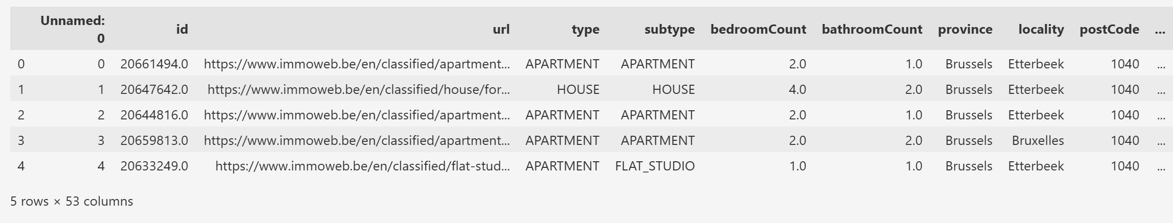
Previewing the Dataset with df.head()
Observation from Dataset Preview
The dataset contains real estate listings with key features such as
property type,
subtype,
number of bedrooms and bathrooms,
location (province, locality, postcode), and a unique listing URL.
From the first 5 rows, we can observe:
A variety of property types (e.g., apartment, house, flat studio)
Listings are located in Brussels, specifically Etterbeek and Bruxelles
Bedroom counts range from 1 to 4, and bathroom counts from 1 to 2

Slide 4
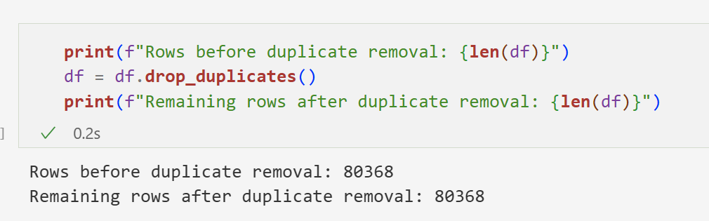
1.1 Remove Duplicates
Observation
No duplicate rows were found in the dataset.
The number of rows remained the same before and after applying drop_duplicates()
→ This confirms that all entries are unique at this stage.

Slide 5
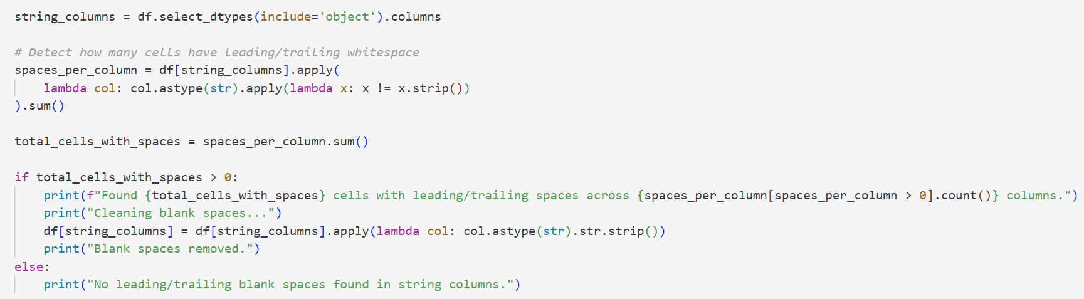
2.2 Remove blank spaces
Observation
No leading/trailing blank spaces found in string columns.
Notes:
What is lambda in Python?
A lambda is a small, anonymous function — a quick way to write a function in one line, without naming it.
Step-by-step explanation of the lambdas
First lambda (column-level): lambda col: ...
This receives one column at a time (e.g., df['title']), and processes each cell inside it.
col.astype(str) converts all values in a column to strings, even if some were numbers, booleans, or missing (NaN).
Second lambda (cell-level): lambda x: x != x.strip()
→ This receives one cell value (e.g., " House "), and checks:
→ " House " ≠ "House" → True → it has extra spaces
"Apartment" = "Apartment" → False → it’s clean
In simple terms:
We use two nested lambda functions to:
Loop over each column (col)
Loop over each cell (x) in that column
Detect if the cell changes when stripped → meaning it had leading/trailing spaces

Slide 6
1.3 Fix any errors or invalid formats
Check | Result | Action / Note
Total missing values | 2 396 576 | Very high – clean or impute
Properties with surface ≤ 0 | 0 | OK
Properties with price ≤ 0 | 0 | OK
Construction year > 2025 | 413 | Filter or correct
Construction year < 1800 | 52 | Investigate or remove
Duplicate rows | 0 | OK
Heating types | GAS, FUELOIL, ELECTRIC, PELLET, SOLAR, CARBON, WOOD | OK
Kitchen types | SEMI_EQUIPPED, INSTALLED, HYPER_EQUIPPED, NOT_INSTALLED, USA_* variants | Normalize naming
Building conditions | GOOD, TO_BE_DONE_UP, AS_NEW, JUST_RENOVATED, TO_RENOVATE, TO_RESTORE | Can be grouped / simplified

Slide 7
1.4 Handle missing values (drop or impute nulls)
Show Percentage of Missing Values
Visualize Missingness – Heatmap using seaborn
Bar plot (via `missingno`) summarizes the missing value count per feature
Save new dataset with missing values removed
Resulting Missing data matrix

Slide 8
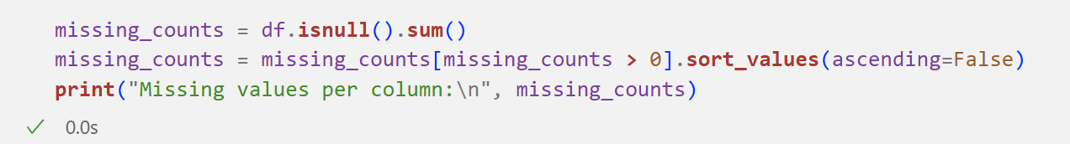
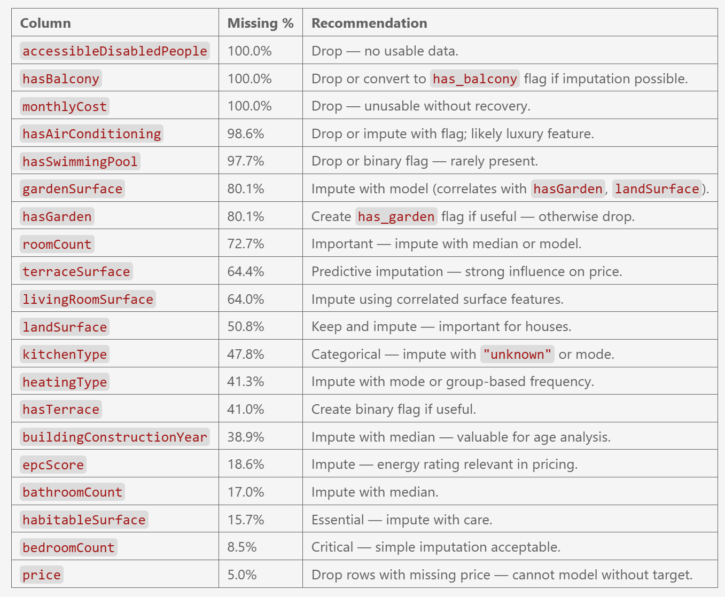
1.4.1 Show Percentage of Missing Values
Key Insight on Missing Data
Drop columns with 100% missing or irrelevant data.
Impute key features (roomCount, terraceSurface, etc.) using median or models.
Fill categorical fields (kitchenType, heatingType) with mode or grouped values.
Remove rows with missing price (target variable).
Keep and impute useful columns (epcScore, constructionYear).

Slide 9
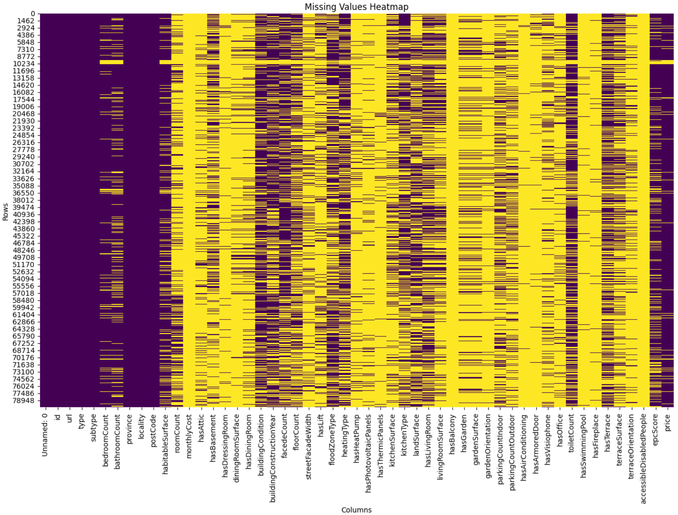
1.4.2 Visualize Missingness – Heatmap using seaborn
Missing Values Heatmap
Yellow indicates missing values
Purple indicates available (non-missing) values
We observe:
Several columns (far right) are mostly yellow, meaning they are almost entirely missing
Most columns have partial missingness, requiring selective imputation
A few columns (left side) are fully populated (purple), and can be safely used
This confirms the need for a hybrid cleaning strategy: drop, impute, or filter depending on importance.

Slide 10
Data analysis
2.1 How many rows and columns are in the dataset?
2.2 What is the correlation between variables and the price?
2.3 Why might those variables be correlated?
2.4 How are variables correlated to each other?
2.5 What might explain these relationships?
2.6 Which variables have the greatest influence on the price?
2.7 Which variables have the least influence on the price?
2.8 How many qualitative (categorical) and quantitative (numerical) variables are there?
2.9 How would you transform categorical values into numeric ones?
2.10 What is the percentage of missing values per column?

Slide 11
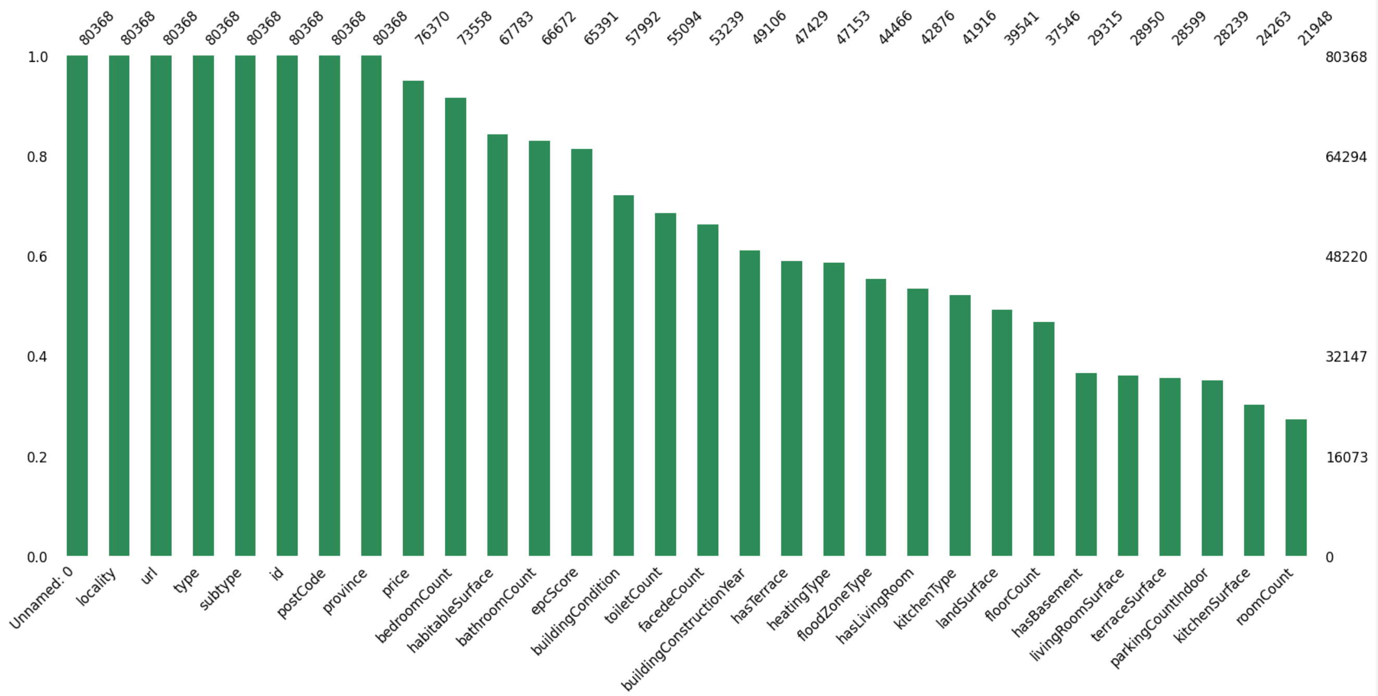
1.4.3 bar plot (via `missingno`) summarizes the missing value count per feature
Column Completeness Overview
Several key variables
“price”, “bedroomCount”,”habitableSurface”, “bathroomCount”
→ are nearly complete and suitable for modeling.
“Surface” & “Room Count” show significant missing values
→ and require imputation or exclusion.
This distribution supports a hybrid data preparation strategy:
retain and clean the most populated columns,
selectively handle incomplete ones based on their importance.

Slide 12
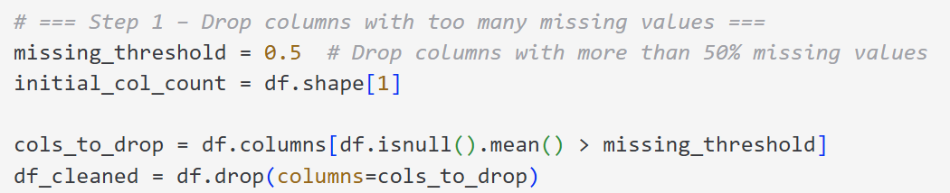
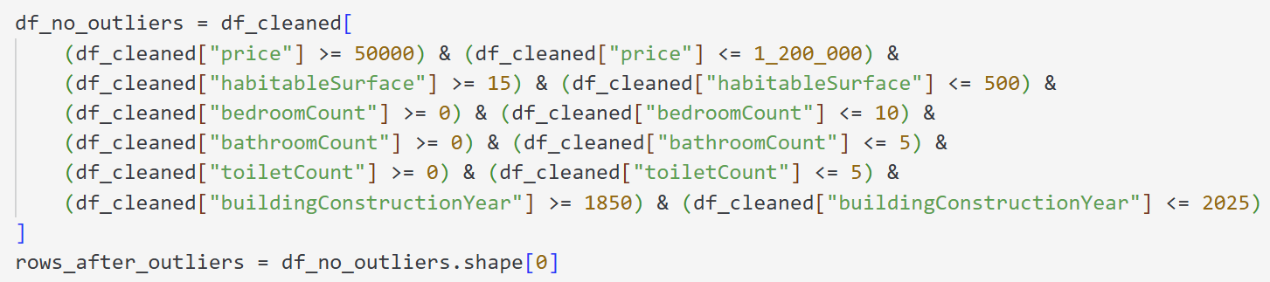
1.4.4 Save new cleaned dataset → 3 steps
1
2
3

Slide 13
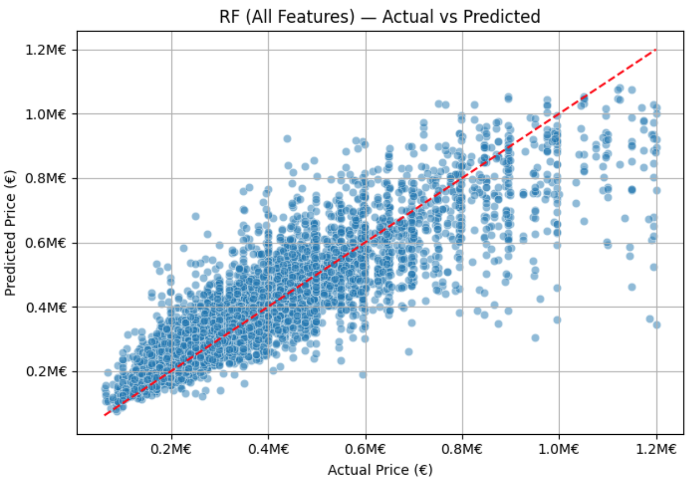
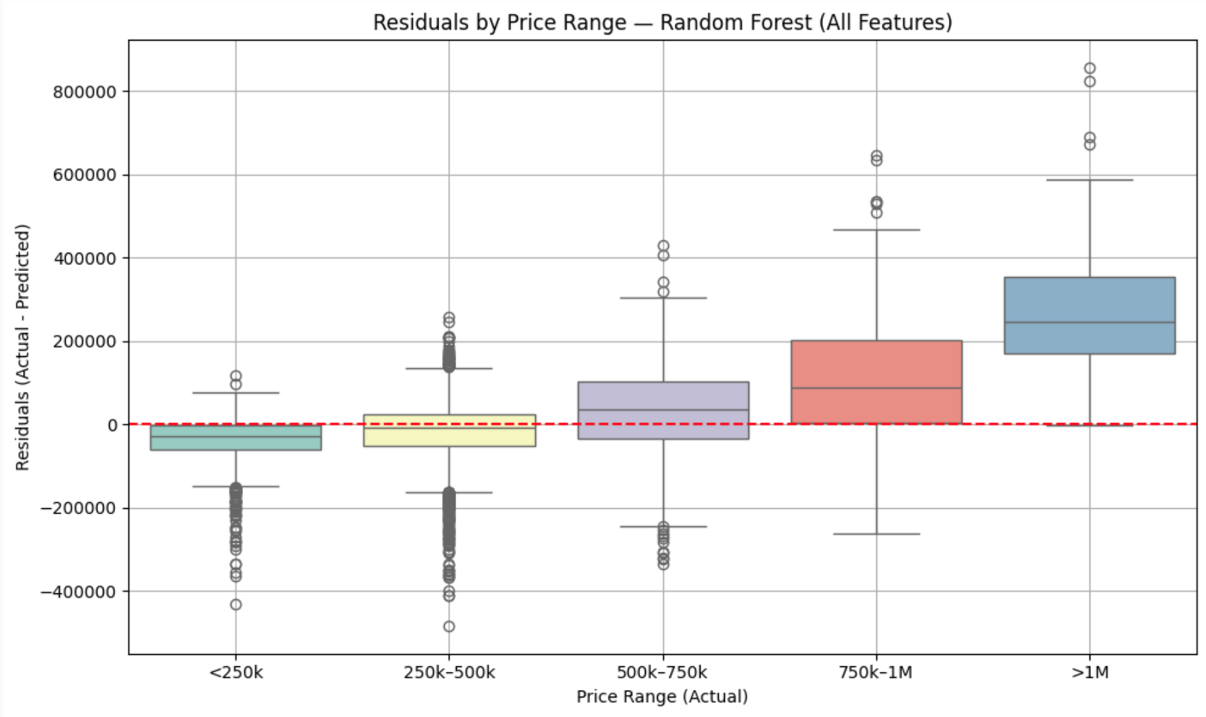
Prediction Limits on High Property Prices
To ensure prediction reliability, we restricted the price range to €1.2M
Above €800k, predictions become more dispersed and less accurate, as shown by the increasing deviation from the diagonal line.
From €750k to over €1M, residuals grow and shift upwards
The model increasingly underestimates high-value properties.
→ This confirms limited reliability for high-end properties, due to less data and more complex patterns.

Slide 14
1.4.4 Save new dataset with missing values removed → 2.1 How many rows and columns remain in the dataset?
Drop columns with a missing threshold = 0.5
(>50% data missing)
Keep only rows with at least 70% non-missing values
Outlier filtering
[50k€ , 1.2M€]
Initial number of columns: 53
Number of columns dropped: 31
Remaining columns: 22
Rows before cleaning: 80 368
Rows removed: 10 243
Remaining rows: 70 125
Rows before outlier removal: 70 125
Rows removed as outliers: 39 936
Remaining rows : 30 189

Slide 15
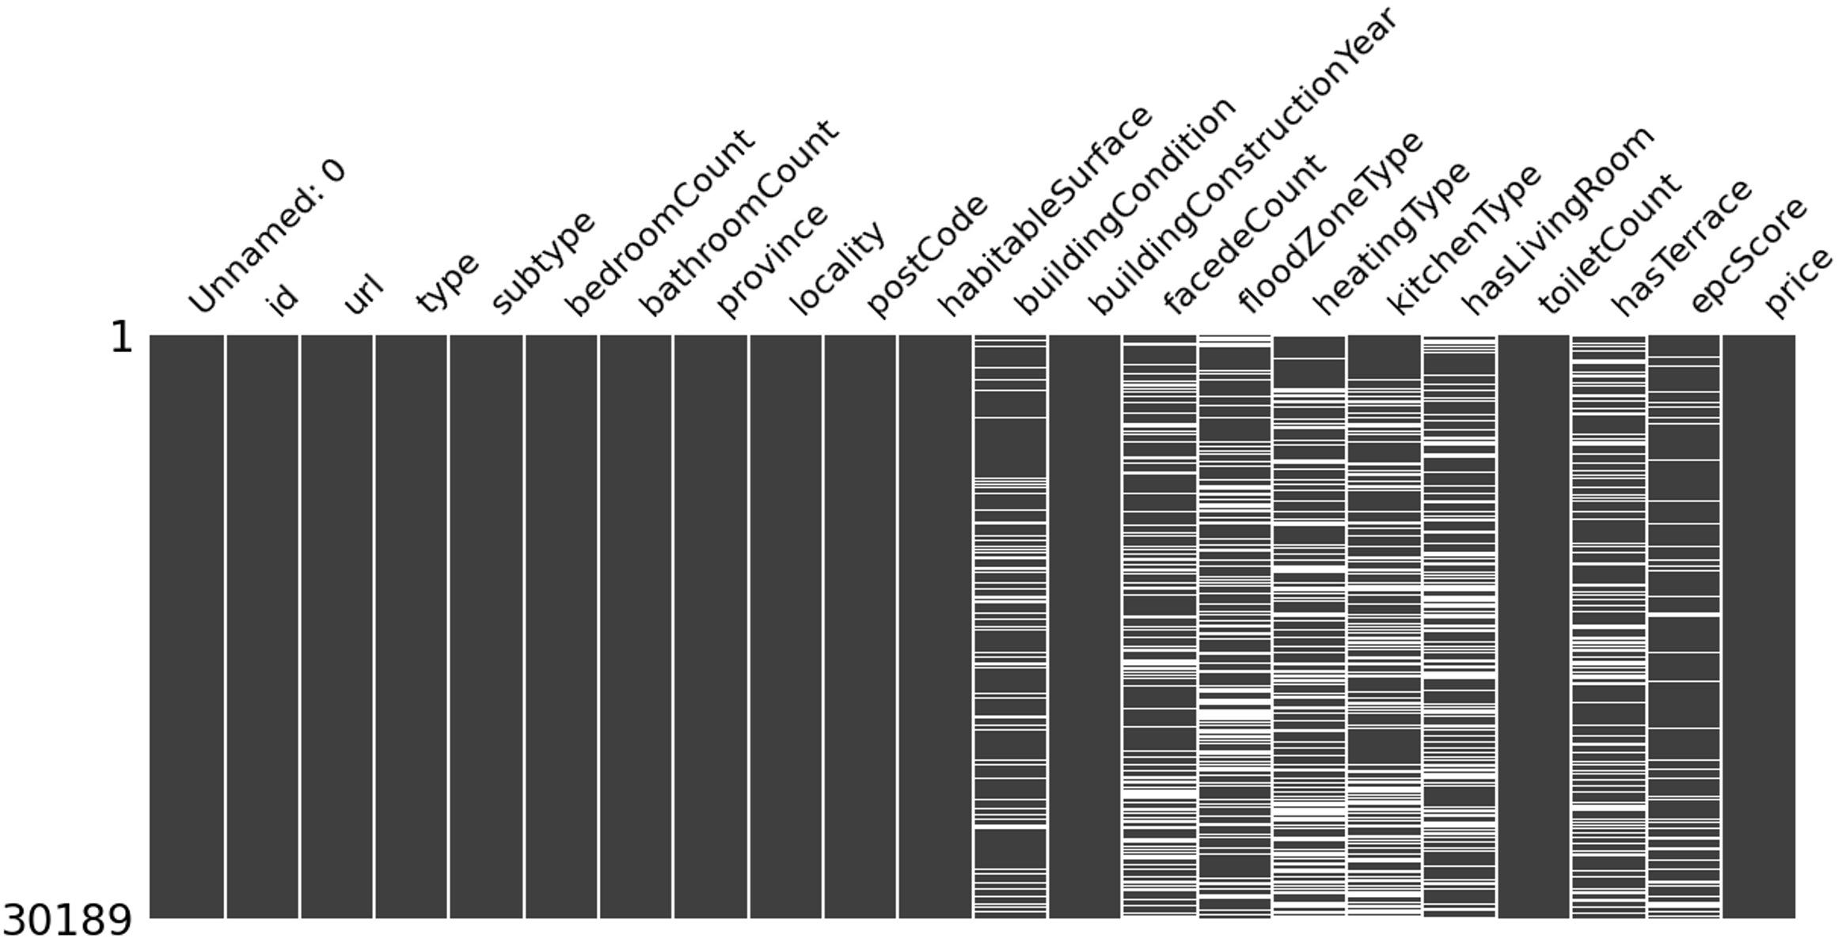
2.1 How many rows and columns are in the dataset? - Missing data matrix

Slide 16
2.2 Matching Statistical Methods to Variable Types
How to measure correlation and association depending on the nature of variables ?
Variable A | Variable B | Type of Variables | Suitable Statistical Method(s)
Binary (0/1) | Continuous (e.g. price) | Binary → Numeric | Point-Biserial Correlation, t-test
Categorical (nominal) | Continuous | Nominal → Numeric | ANOVA, Kruskal-Wallis
Binary | Binary | Binary ↔ Binary | Phi coefficient, Chi-square test
Categorical | Categorical | Nominal ↔ Nominal | Cramér’s V, Chi-square test
Continuous | Continuous | Numeric ↔ Numeric | Pearson, Spearman Correlation
Ordinal | Continuous | Ordinal → Numeric | Spearman correlation
Various Features | Target (Price) | Mixed types | Random Forest Regression, Lasso Regression
Note:
Even after preprocessing (e.g., OneHot, Ordinal Encoding), original variable types still matter.
Avoid misinterpreting encoded categorical data as truly continuous.
Use appropriate statistical methods based on semantic nature, not just technical encoding.

Slide 17
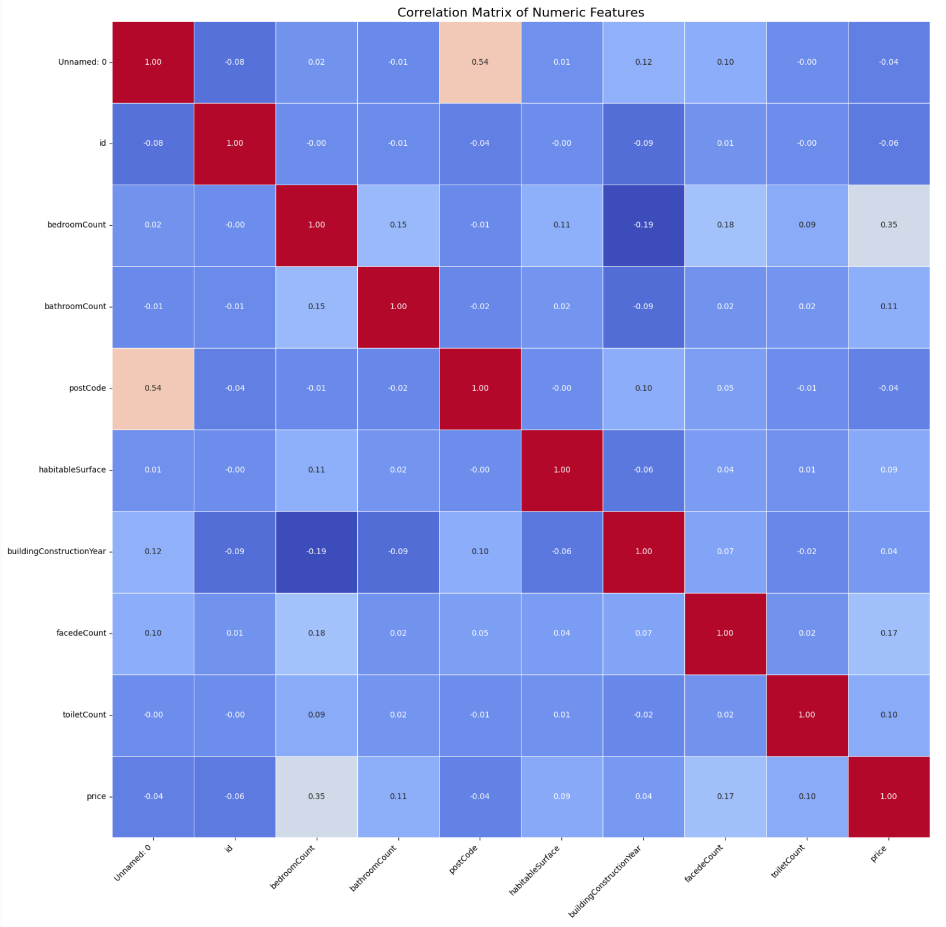
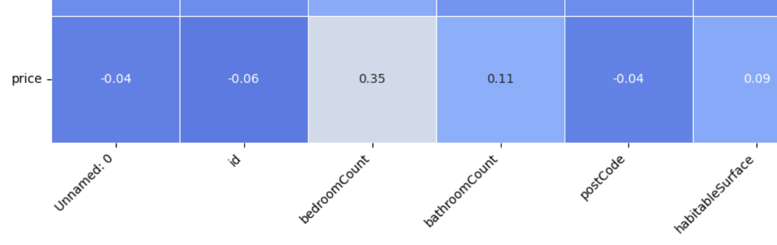
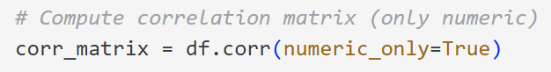
2.3 Why might those variables be correlated?
Variable | Correlation with price | Interpretation
bedroomCount | 0.35 | More bedrooms generally indicate higher property value. This is an expected relationship.
facedeCount | 0.17 | More facades often suggest better location or larger/more valuable properties.
epcScore | 0.10 | Weak correlation; slightly better energy performance appears linked to higher prices.
bathroomCount | 0.11 | Moderate impact; additional comfort adds perceived value.

Slide 18
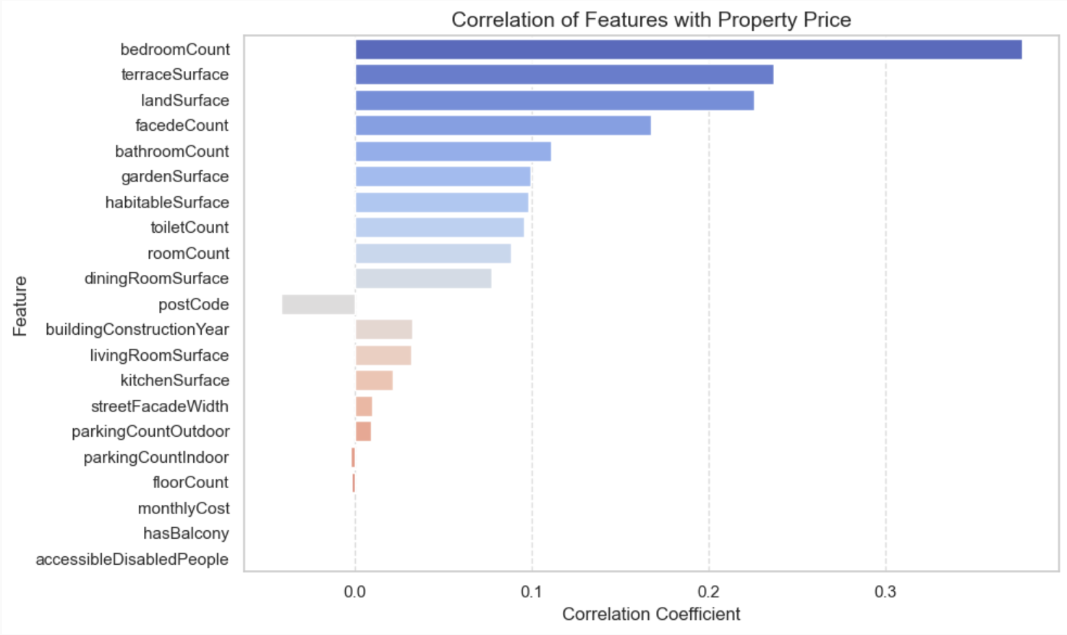
2.2 a.What is the correlation between variables and the price? (Pearson correlation 1/2)
Price Correlation Insights
The most correlated features with property price are bedroom count, terrace surface, and land surface.
Surface-related variables dominate the top influencers, confirming that size matters most in real estate valuation.
Some features (e.g., monthlyCost, hasBalcony) show negative or negligible correlation, and may require further validation or exclusion from models.

Slide 19
2.2 A. Feature Correlation with Price (Pearson correlation 2/2)
Purpose : assess linear relationship between numeric variables and the target price
We compute the Pearson correlation coefficient: df.corr(numeric_only=True) (Pandas library)
Features considered
Surface-related variables | Count variables | Temporal/numeric fields
habitableSurface | bedroomCount | buildingConstructionYear
landSurface | bathroomCount | monthlyCost
terraceSurface | toiletCount | epcScore
livingRoomSurface | roomCount
kitchenSurface | floorCount
gardenSurface | facedeCount…
Pearson correlation only applies to continuous numerical variables.
For binary and categorical features (e.g., province, hasTerrace), alternative statistical approaches are used and detailed in the next slides:
Point-biserial correlation
ANOVA/Kruskal

Slide 20
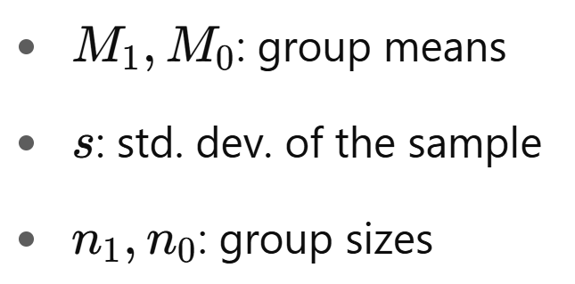
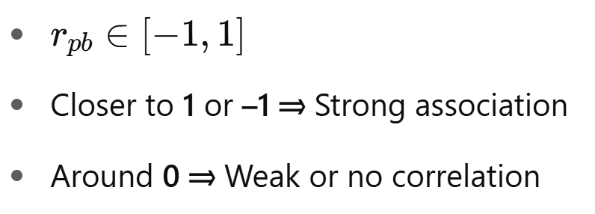
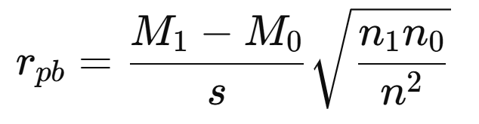
2.2 b. Binary Categorical Variables (1/2)
Why use Point-Biserial ?
It’s a special case of Pearson, adapted to binary categories (0/1).
Assess whether a binary feature (e.g. hasTerrace) influences a continuous target (price), using Point-Biserial Correlation
Group | Mean Price (€) | Description
hasTerrace = 1 | 350 000 € | With terrace
hasTerrace = 0 | 270 000 € | Without terrace
r_pb = 0.18 (around 0) ➔ Weak to moderate positive effect

Slide 21
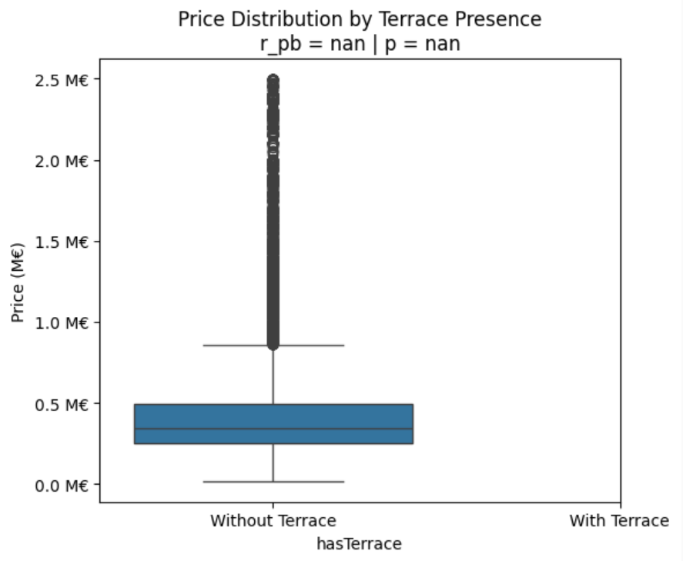
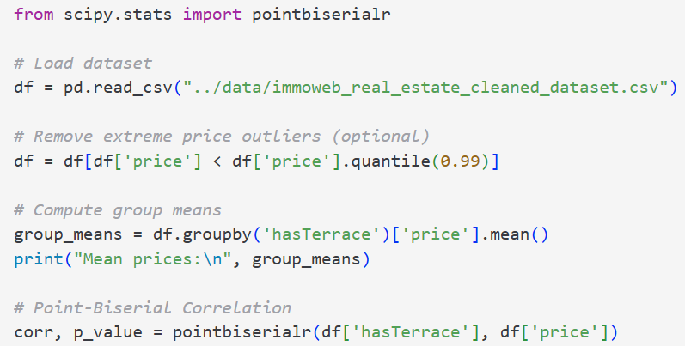
2.2 b. Binary Categorical Variables (2/2)
Computation

Slide 22
2.2 C. Statistical Correlation: Province vs. Price (ANOVA / Kruskal-Wallis 1/2)
Why not use Pearson correlation?
Province is a categorical variable, not continuous ⇒ Pearson is not applicable.
We need to assess whether price significantly varies by province.
Summary of Statistical Tests
Test | Description | Null Hypothesis (H₀) | Core Idea
ANOVA (F-test) | Parametric test comparing group means (e.g. price across provinces) | All group means are equal | Ratio of between-group / within-group variance
Kruskal-Wallis | Non-parametric test comparing rank distributions across groups | All group distributions are equal | Compares ranks rather than actual values
0,000 => not equal
Results on Real Estate Data
Test | P-value | Null Hypothesis (H₀)
ANOVA | 0,000 | Mean prices differ significantly across provinces
Kruskal-Wallis | 0,000 | Distributions of prices also differ across provinces

Slide 23
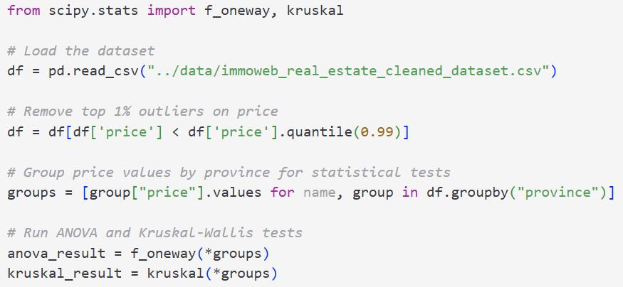
2.2 C. Statistical Correlation: Province vs. Price (ANOVA / Kruskal-Wallis 2/2)
Computation

Slide 24
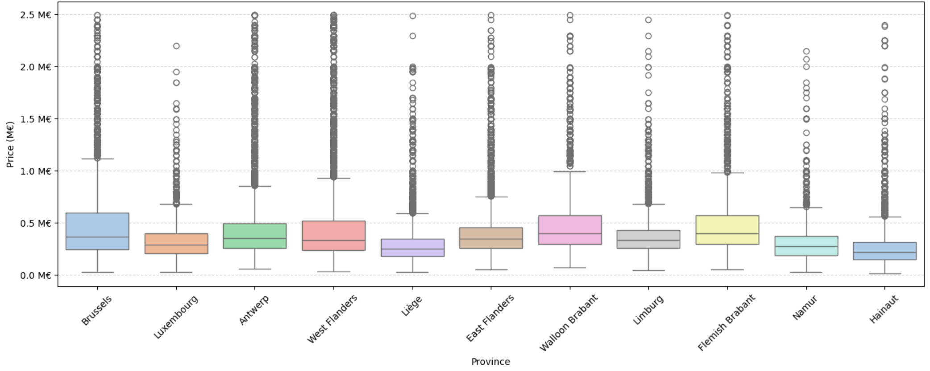
2.2 C. Price distribution by Province

Slide 25
2.4 How are variables correlated to each other?
Bedroom count and bathroom count are moderately correlated.
Bedroom count shows the strongest link to price (~0.35).
Facede count has a weak but visible correlation with price (~0.17).
EPC score, habitable surface, and toilet count show weak correlations.
Building year has little to no correlation with other features.
Postcode has no linear relation to price — it's categorical.
Overall, correlations are weak to moderate.
A combination of features is needed to explain price.
Conclusion
Build a multivariate model (e.g., Linear Regression, Random Forest, XGBoost…)
Engineer new features (e.g., price_per_m2, building_age)
Evaluate performance with Root Mean Squared Error (RMSE), Coefficient of Determination (R²), and cross-validation
Next steps

Slide 26
2.5 What might explain these relationships? 2.6 - 2.7 variables have the greatest/ least influence on the price?
Greatest Influence on Price
Bedroom Count is the top correlated feature.
Terrace surface, land surface, and facede count also matter.
All are linked to size and space, key drivers of property value.
Least / Negative Influence
monthlyCost, hasBalcony, accessibleDisabledPeople show low or negative correlation.
These may lack clear market impact or be inconsistently reported.
Consider dropping or transforming them in modeling.

Slide 27
2.8 How many qualitative (categorical) and quantitative (numerical) variables are there?
Quantitative variables (numerical):['Unnamed: 0', 'id', 'bedroomCount', 'bathroomCount', 'postCode', 'habitableSurface', 'buildingConstructionYear', 'facedeCount', 'toiletCount', 'price’]
Qualitative variables (categorical):['url', 'type', 'subtype', 'province', 'locality', 'buildingCondition', 'floodZoneType', 'heatingType', 'kitchenType', 'hasLivingRoom', 'hasTerrace', 'epcScore']
- Quantitative variables are numerical and can be used in mathematical operations, plots, and statistical summaries.
- Qualitative variables (also called categorical) describe categories or labels and often require encoding or grouping before use in machine learning.
Variable Types Identified
The cleaned dataset includes a mix of quantitative (numerical) and qualitative (categorical) variables.
Numerical features (e.g. price, bedroomCount, habitableSurface) are ready for statistical analysis and modeling.
Categorical features (e.g. type, province, heatingType) will require encoding or grouping before use in machine learning models.

Slide 28
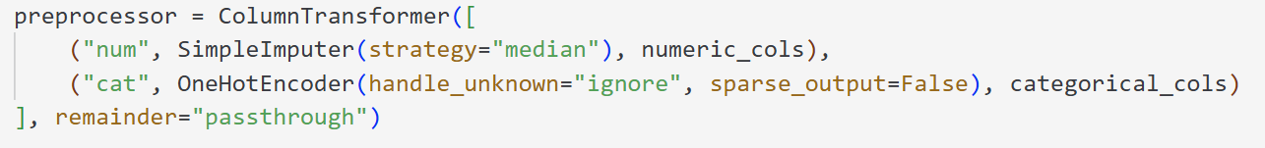
2.9 How would you transform categorical values into numeric ones?
Apply pre-processing pipeline (scikit-learn library)
Explanation
Numerical features are imputed using the median to handle missing values.
Categorical features are transformed using OneHotEncoder, which converts each category into binary columns.
Unknown categories are safely ignored (handle_unknown="ignore").
The ColumnTransformer keeps everything organized in a single preprocessing pipeline, ready to be integrated into a machine learning model.
Result
→ All data (numerical + categorical) becomes fully numeric and model-compatible → This pipeline is robust, reusable, and ensures clean preprocessing for training

Slide 29
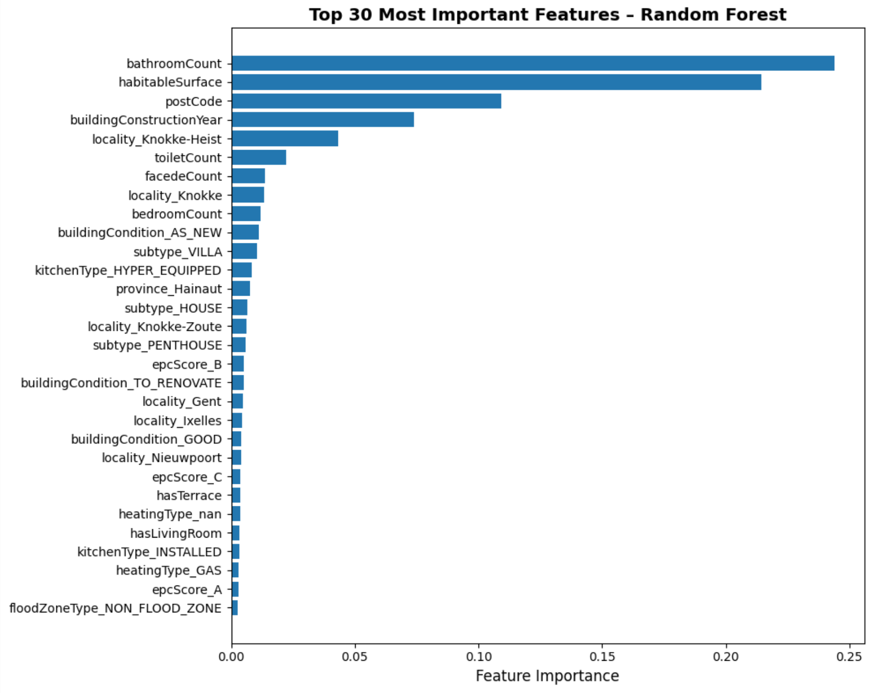
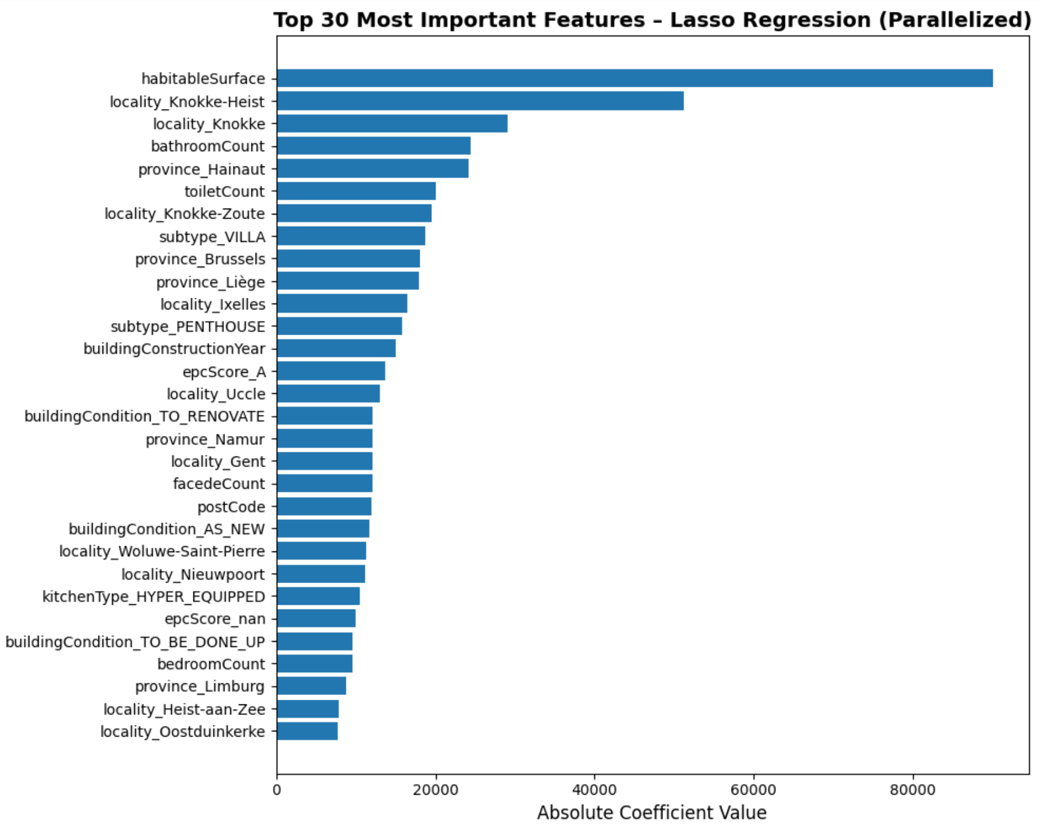
2.2 FEATURE IMPORTANCE & CORRELATION ANALYSIS USING RANDOM FOREST AND LASSO REGRESSION
Both models confirm that habitable surface, bathroom count, and location variables (e.g., Knokke-Heist, province Hainaut) are strong predictors of price.
Random Forest emphasizes nonlinear interactions and physical attributes (e.g., building age, number of facades).
Lasso Regression focuses more on location granularity and penalizes less informative features.
Differences in feature ranking reflect how each model processes variable types, captures relationships, and applies regularization or interaction effects.

Slide 30
2.10 What is the percentage of missing values per column?
Column Completeness Overview
Several key variables
“price”, “bedroomCount”,”habitableSurface”, “bathroomCount”
→ are nearly complete and suitable for modeling.
“Surface” & “Room Count” show significant missing values
→ and require imputation or exclusion.
This distribution supports a hybrid data preparation strategy:
retain and clean the most populated columns,
selectively handle incomplete ones based on their importance.

Slide 31
Step 3 Data interpretation
3.1 Plot the outliers (visually detect anomalies)
3.2 Which variables would you delete and why?
3.3 Create a histogram showing the number of properties by surface area
3.4 In your opinion, which 5 variables are the most important and why?
3.5 What are the most expensive municipalities in Belgium? (average price, median price, price per m<sup>2</sup>)
3.6 What are the most expensive municipalities in Wallonia?
3.7 What are the most expensive municipalities in Flanders?
3.8 What are the least expensive municipalities in Belgium?
3.9 What are the least expensive municipalities in Wallonia?
3.10 What are the least expensive municipalities in Flanders?

Slide 32
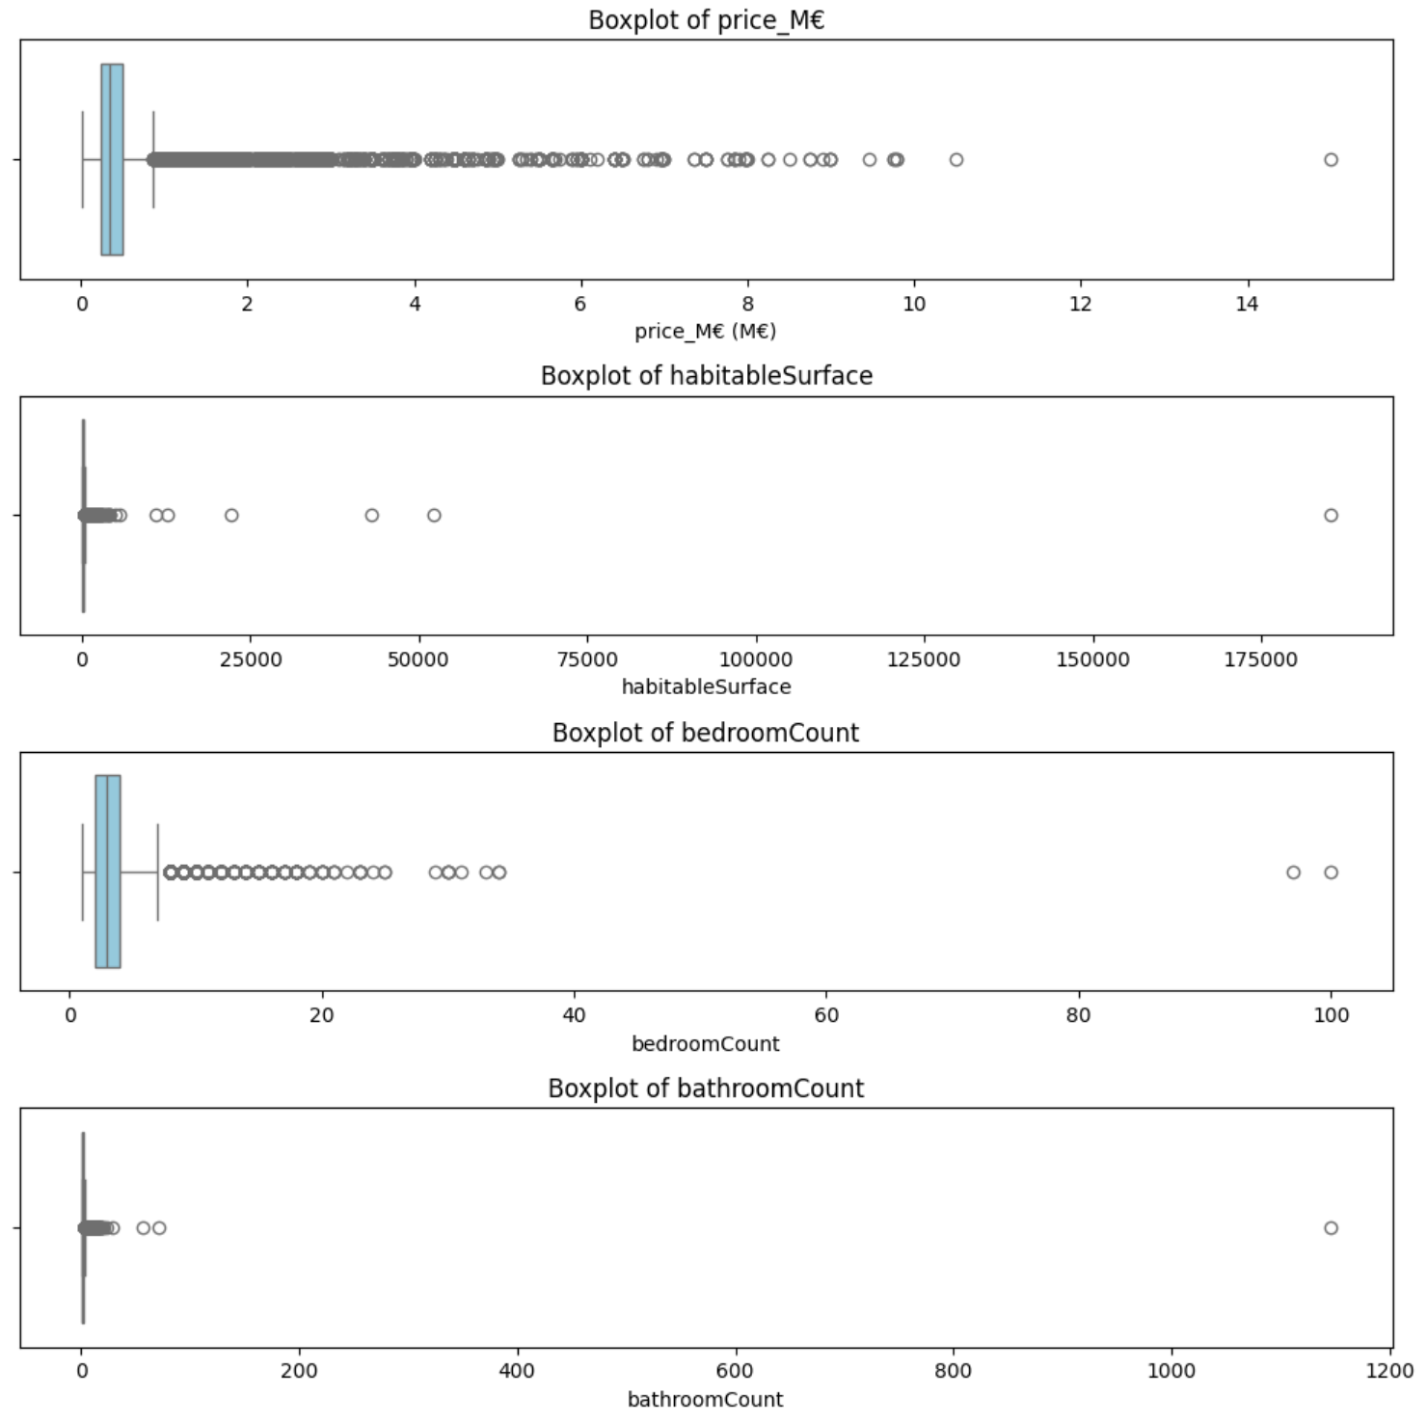
3.1 Plot the outliers (visually detect anomalies)
Outlier Detection Insights
Price (in M€)
→ Most listings fall below 2 M€, but a long tail of outliers exists up to ~15 M€.
→ Likely includes luxury or exceptional properties.
Habitable Surface
→ Extreme outliers beyond 50,000 m², and one over 175,000 m², which is likely a data entry error.
→ Most values cluster well below 1,000 m².
Bedroom Count
→ Majority of listings have 1 to 5 bedrooms, but outliers reach over 100, which is unrealistic for residential listings.
Bathroom Count
→ Normal values are mostly under 5.
→ Outliers above 100 bathrooms strongly suggest data quality issues.
Many variables contain extreme values or anomalies, due to:
high-end/luxury properties, or
data errors
→ These outliers should be cleaned before model training to avoid distortion.

Slide 33
3.2 Which variables would you delete and why?
Delete due to low relevance or quality
Flagged as suspicious or incorrect
Why delete them?
monthlyCost: low or negative correlation with price, inconsistent or missing data.
hasBalcony, accessibleDisabledPeople: mostly binary with weak signal, and rare values.
parkingCountIndoor, parkingCountOutdoor: poor completeness, often missing or zero.
floorCount: low correlation and limited variance.
streetFacadeWidth: potentially redundant with facedeCount, and often missing.
bathroomCount > 100
bedroomCount > 30
habitableSurface > 50,000 m²
These likely result from data entry errors
→ should be cleaned or capped.
Reduce noise in the model
Improve training performance
Avoid overfitting on rare or erroneous data
Focus on variables with meaningful, consistent impact

Slide 34
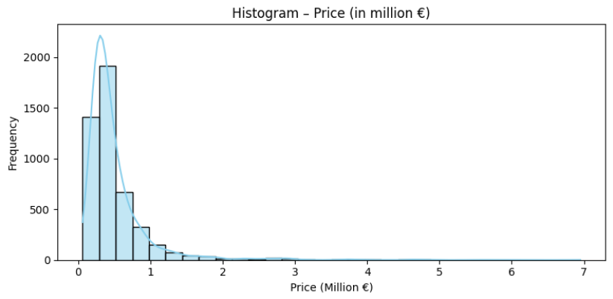
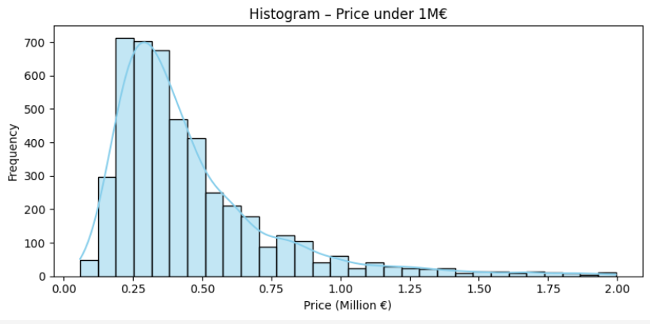
Option - Distribution visualization
Price Distribution
The overall price distribution is right-skewed, with a long tail of high-priced properties.
Most listings are concentrated below €1 million, justifying a focused view on this price range.
The filtered histogram (under €1M) reveals a peak around €250,000–€400,000, aligning with typical residential property prices.
Outliers above €1M should be handled carefully during modeling (e.g., scaling, trimming, or log transformation).

Slide 35
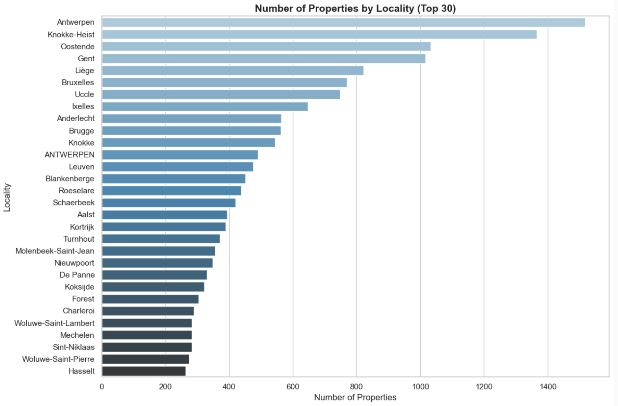
3.3 showing the number of properties by geographical area

Slide 36
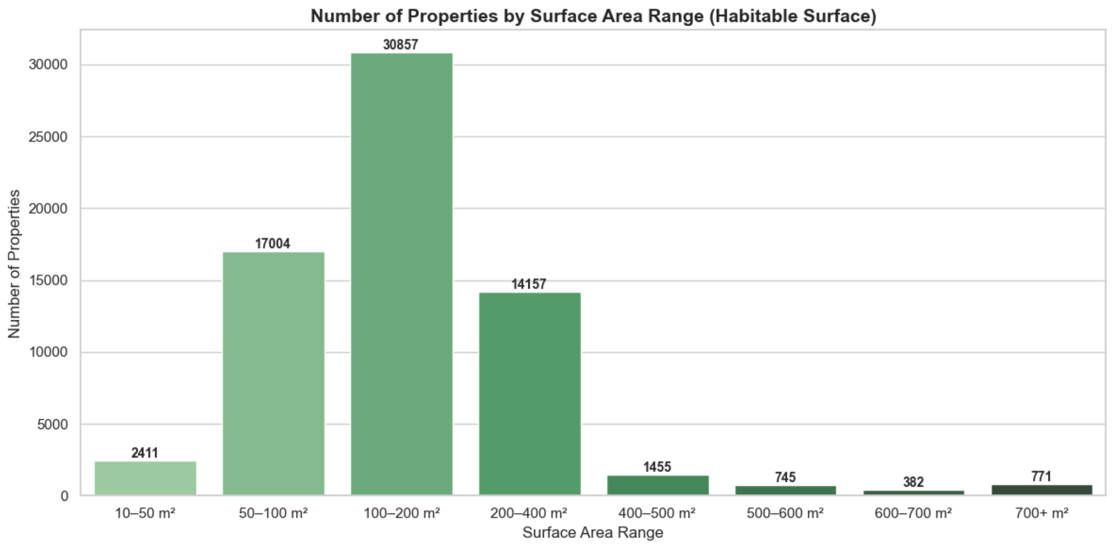
3.3 showing the number of properties by Habitable surface

Slide 37
3.4 Most Important Variables (and Why)
Most Predictive Variables – Why They Matter
Bedroom Count
Strongest positive correlation with price.
More bedrooms usually imply a larger and more valuable property.
Habitable Surface
Directly linked to the size of the property.
Larger homes are typically more expensive, despite some noisy data
Facede Count
More facades often mean better location, light, and standing.
Strong visual indicator of property type and size.
Subtype (categorical)
Differentiates houses, apartments, villas, etc.
Affects both price range and buyer expectations.
PostCode (categorical / locational)
Proxy for (shortcut to capture) location, one of the most crucial & influential factors in real estate.
High-price areas consistently show higher averages.

Slide 38
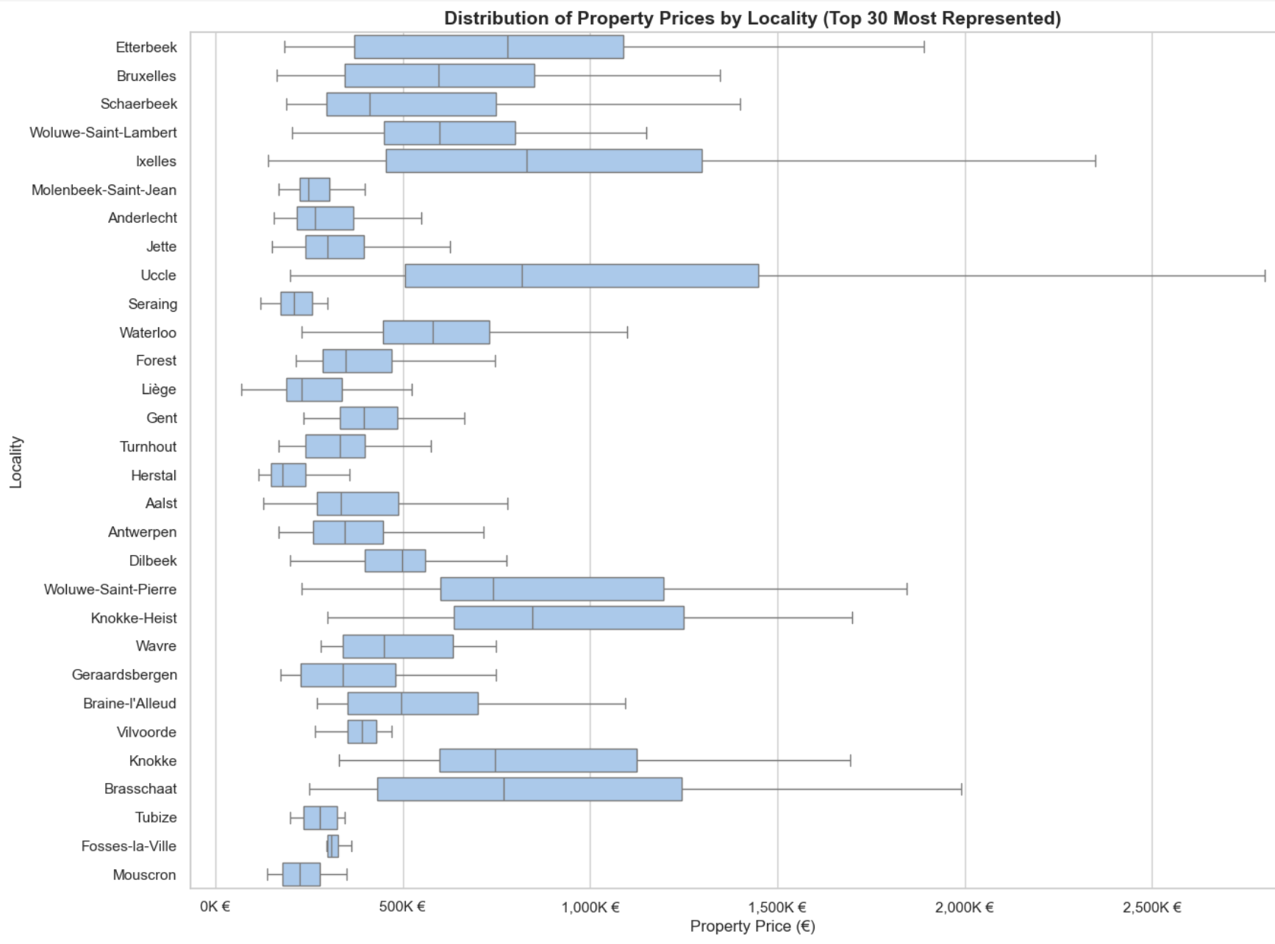
Option - Most expensive municipalities in Belgium
Price Extremes by Locality
Property prices show strong variation by locality.
Ixelles, Uccle, and Knokke stand out as high-end areas
Mouscron, Tubize, and Fosses-la-Ville represent the lower end
Location remains a key factor in pricing dynamics

Slide 39
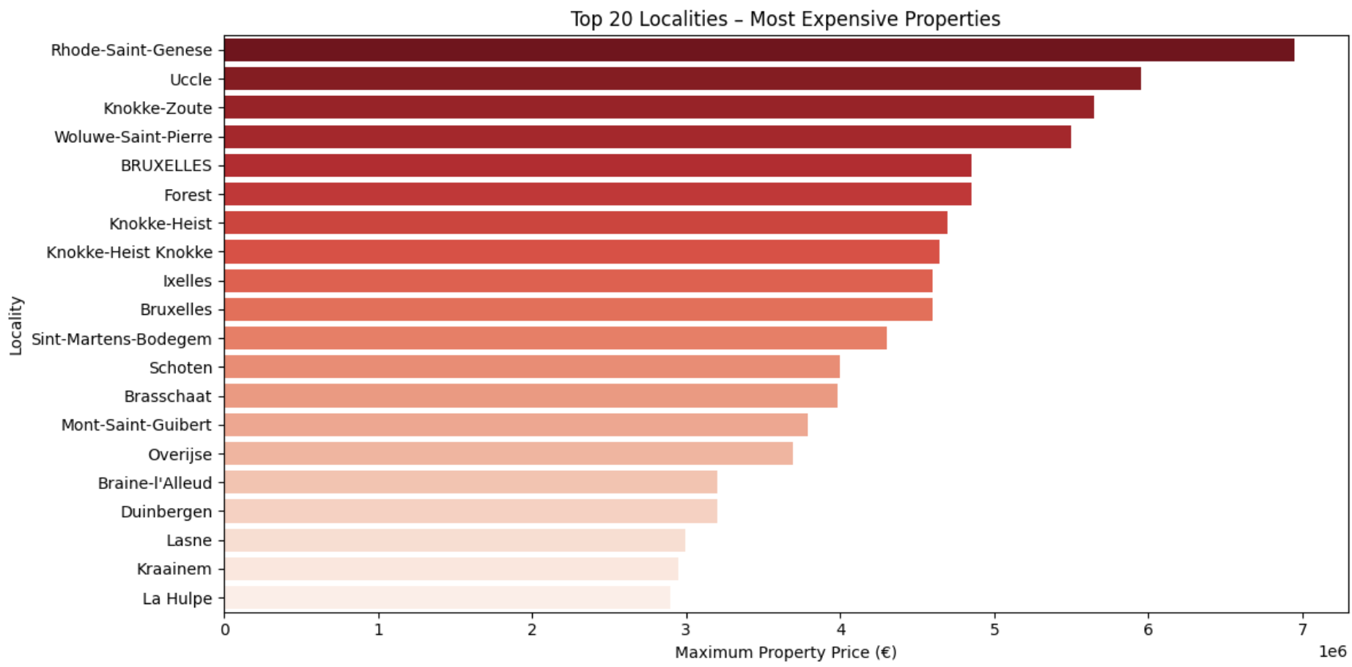
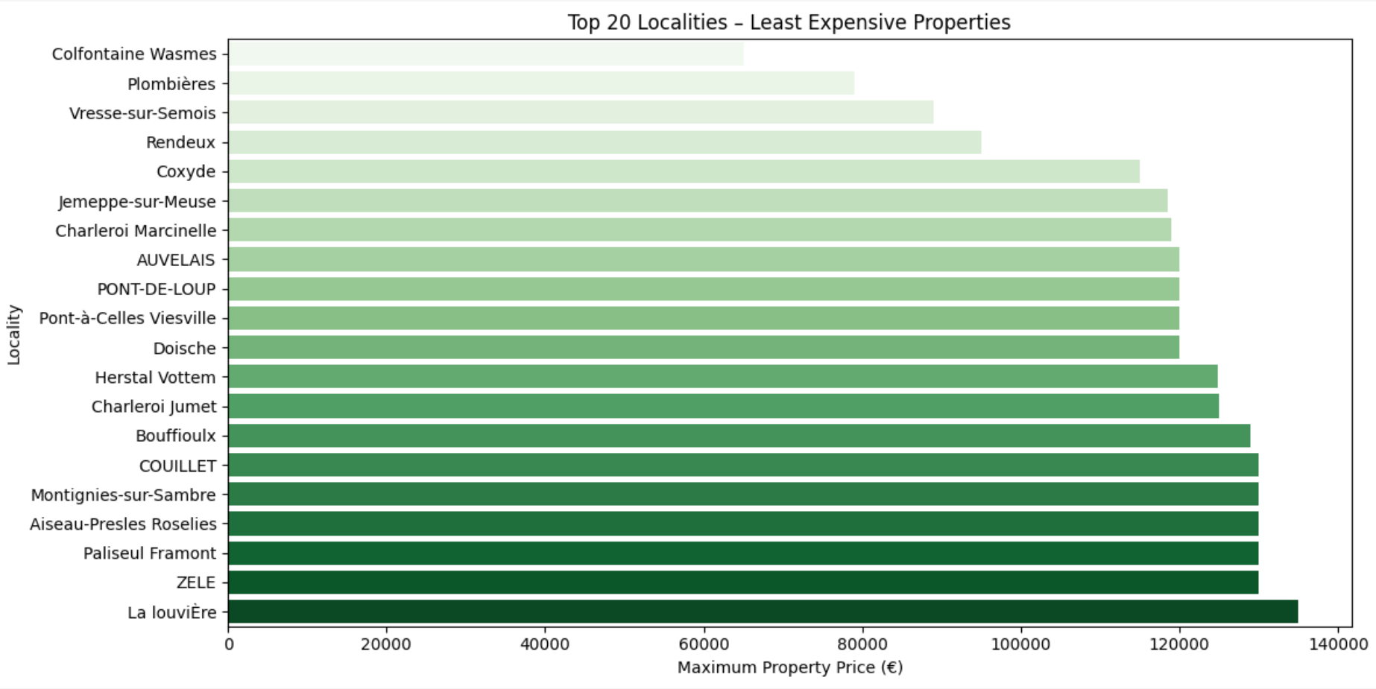
3.9 Most & Least Expensive per town
Price Extremes by Locality
Most expensive localities include
Rhode-Saint-Genèse, Uccle, and Knokke-Zoute,
→ with maximum prices exceeding €6 million.
Least expensive areas such as
La Louvière, Zele, and Pasilieu Ramont
show max prices below €140,000,
→ indicating strong regional disparities.
This contrast highlights regional and socioeconomic gaps
→ key for location-based modeling.

Slide 40
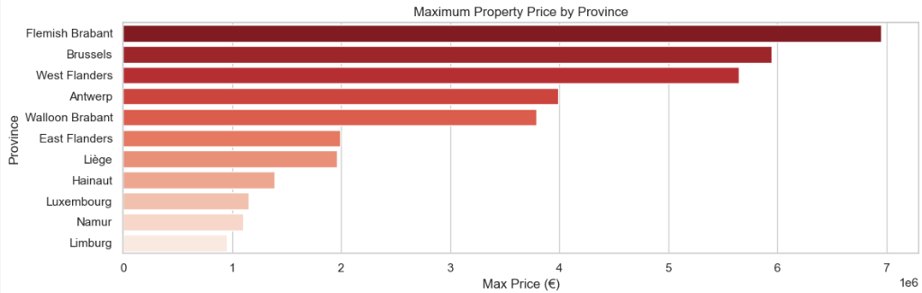
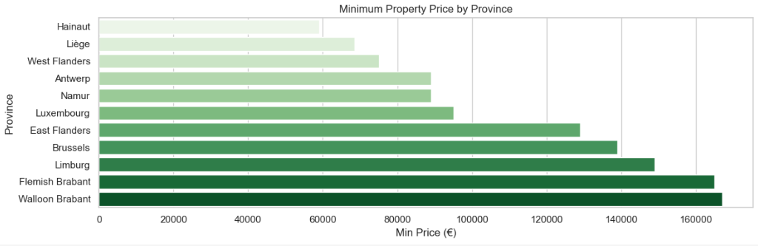
Option - Most & Least Expensive per province
Price by Province
Flemish Brabant, Brussels, and West Flanders have the highest maximum property prices, reaching up to €6–7 million.
Walloon provinces like Hainaut and Liège have the lowest minimum prices, below €50,000.
This wide price range across provinces highlights the importance of regional pricing strategies in real estate modeling.

Slide 41
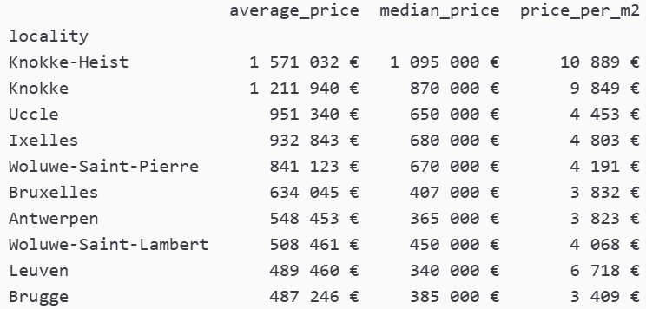
3.5 Top 10 most expensive municipalities (by average price) in beLgium (1/2)

Slide 42
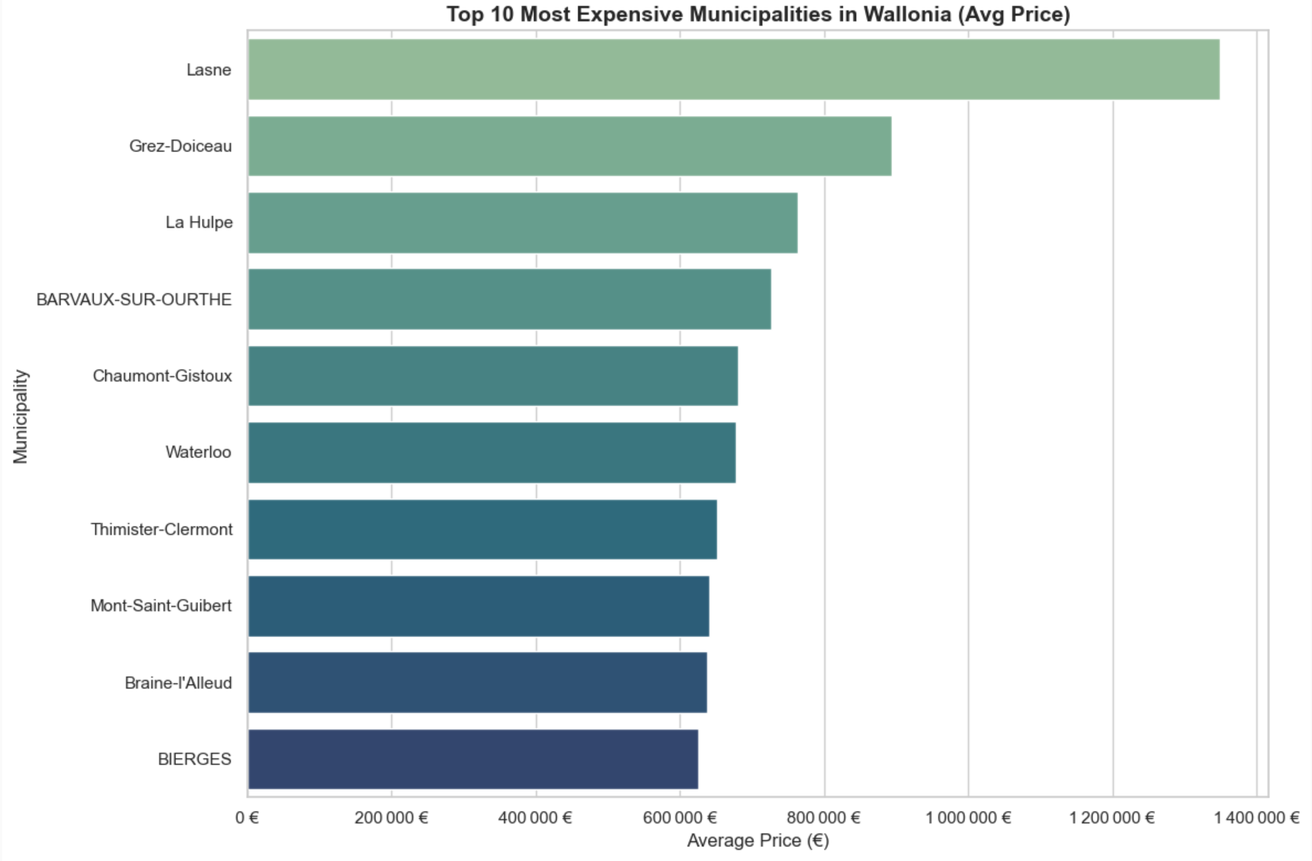
3.6 What are the most expensive municipalities in Wallonia?

Slide 43
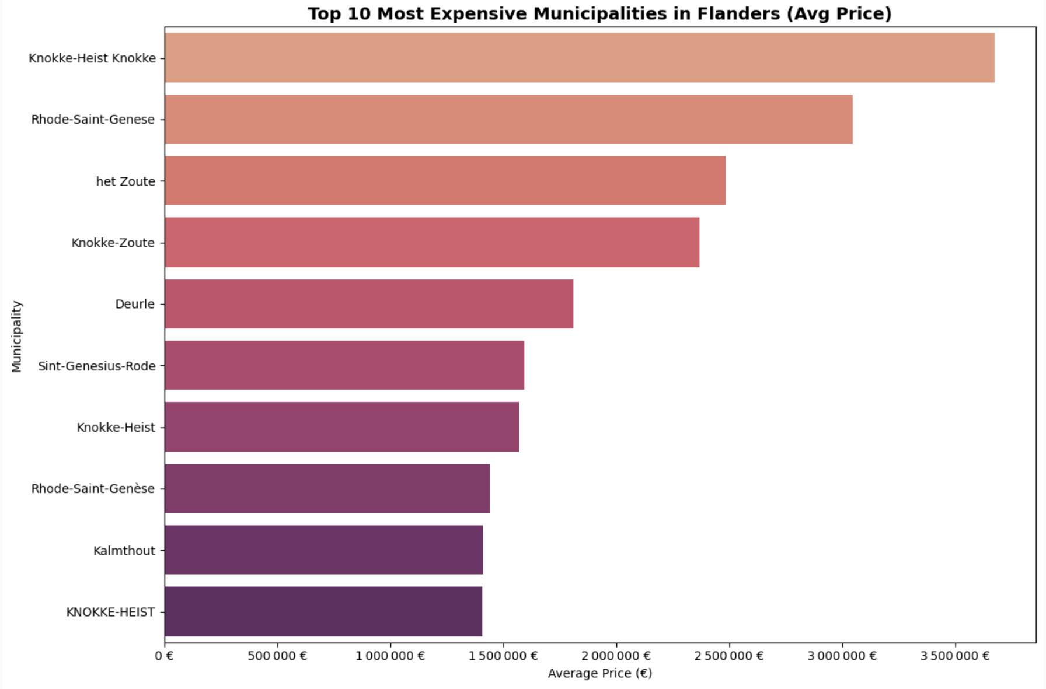
3.7 What are the most expensive municipalities in Flanders?

Slide 44
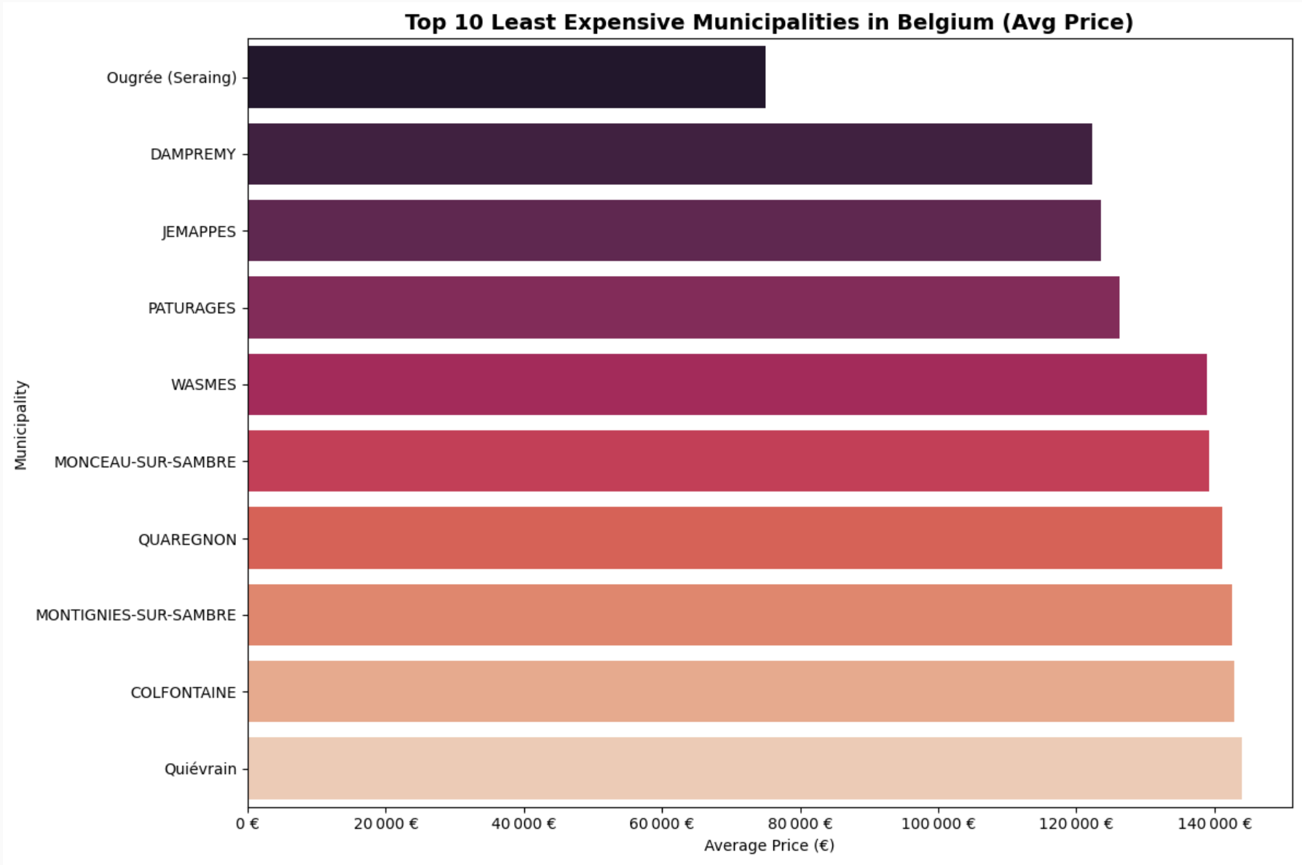
3.8 What are the least expensive municipalities in Belgium?

Slide 45
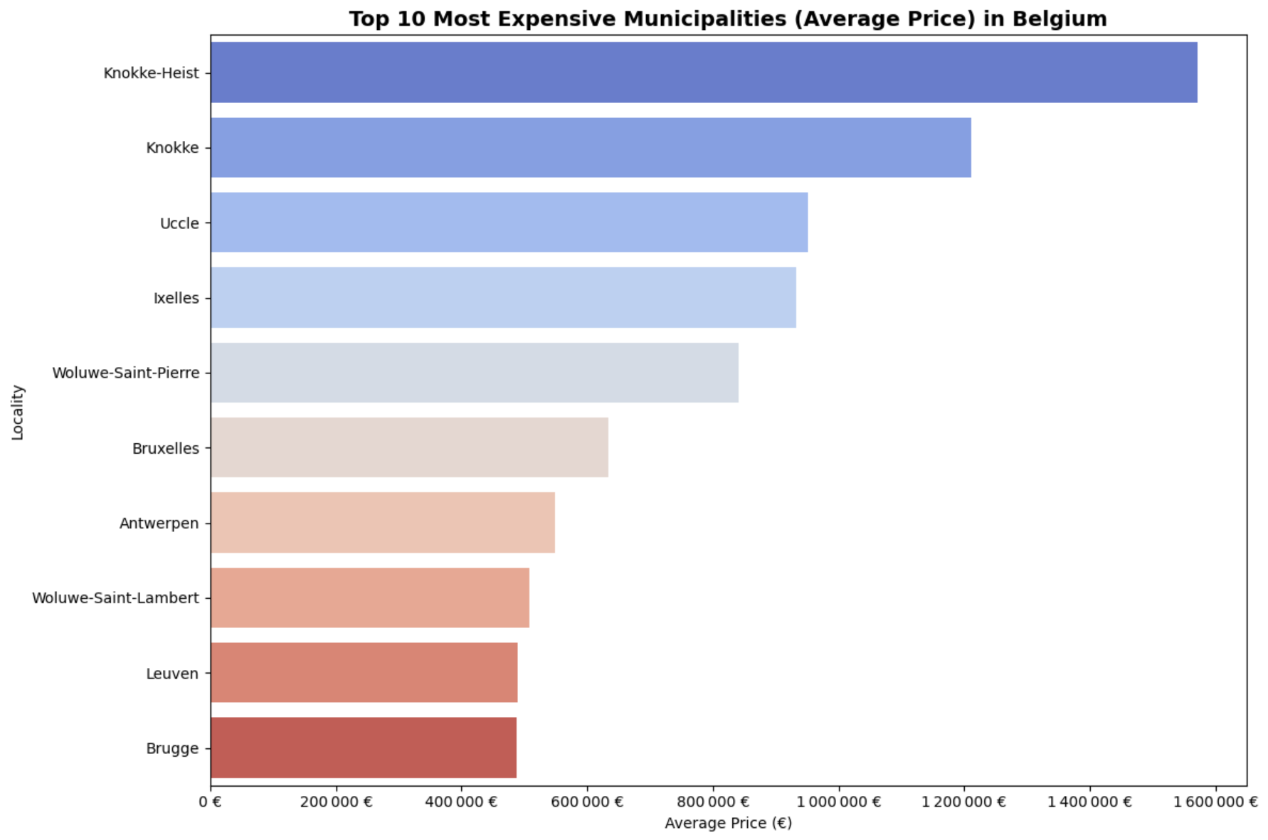
3.8 Top 10 most expensive municipalities (by average price) in beLgium (2/2)

Slide 46
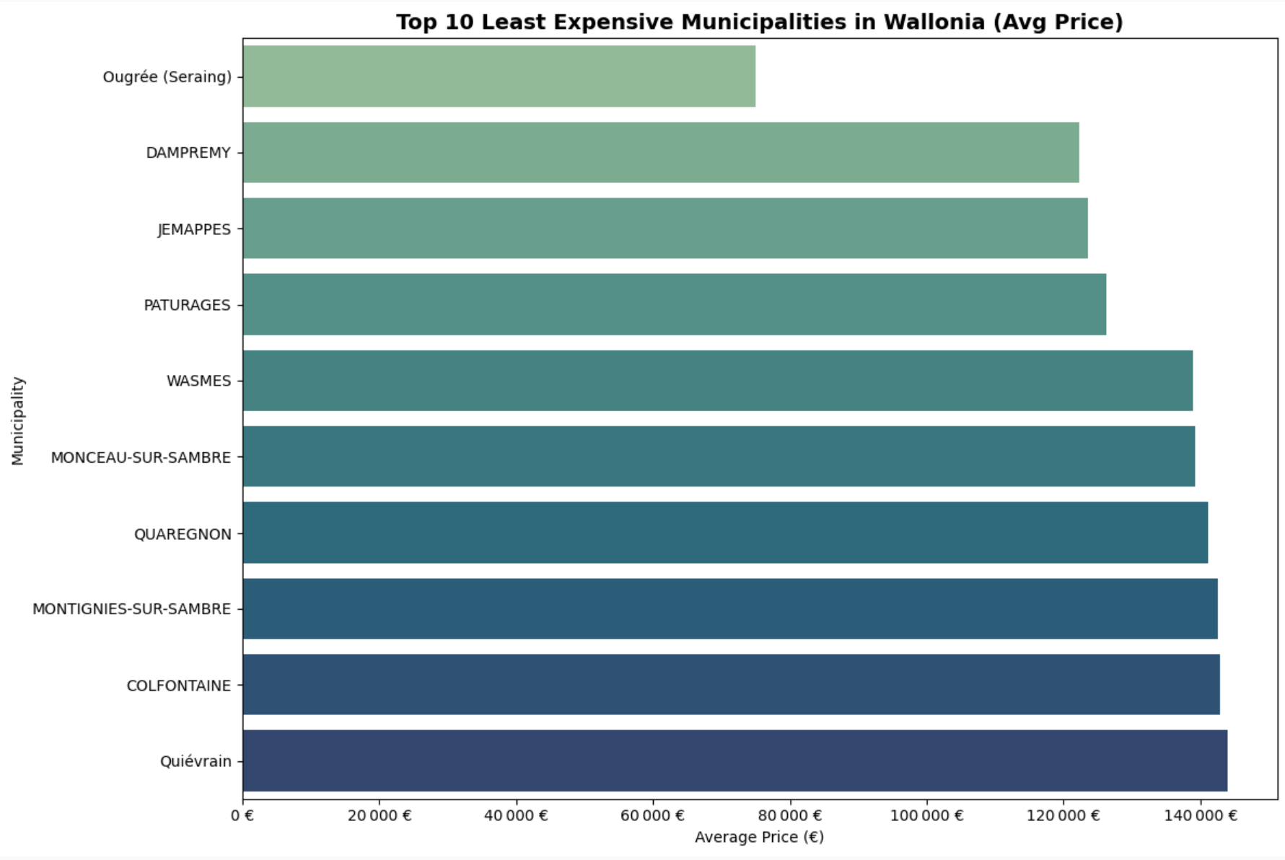
3.9 What are the least expensive municipalities in Wallonia?

Slide 47
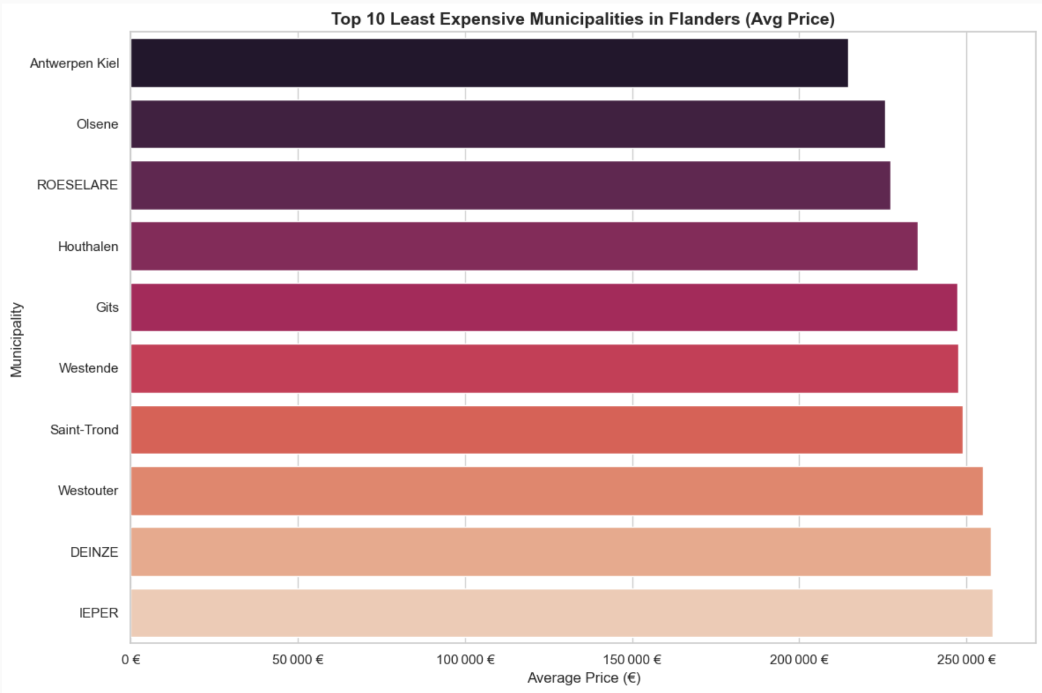
3.10 What are the least expensive municipalities in Flanders?

Slide 48
Conclusion
Size and features matter
Location is crucial
Outliers and data quality need attention
No single variable can predict price accurately
Machine learning improves prediction
Variables like
Bedroom Count,
Terrace Surface,
Habitable Surface
are among the strongest drivers of price
confirming that larger and better-equipped properties
command higher value
Post Code serves as a strong proxy for location
one of the most influential factors in real estate.
Regional and municipal differences
→ explain large price variations
Several extreme values in
surface
or room counts
suggest the need for robust cleaning (and validation)
before model training
Correlations with price are generally
weak
to moderate.
This confirms that
a combination of features,
along with feature engineering,
→ is needed to build effective models.
Advanced models like
Random Forest
and
XGBoost particularity
→ outperform linear regression,
especially when
all engineered
and cleaned features are used.

Slide 49
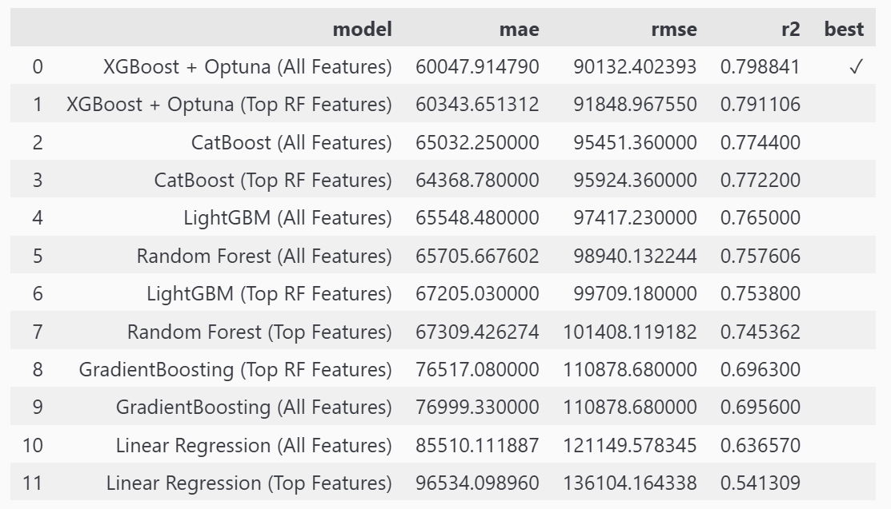
Model Comparison – Real estate price Prediction
Metrics
Model Performance Comparison
Metrics | Description
MAE (Mean Absolute Error) | Average absolute deviation from actual prices (in euros) Lower is better.
RMSE (Root Mean Squared Error) | Penalizes large errors more than MAE Also, in euros. Lower is better.
R² (R-squared) | Coefficient of determination Explains how much of the variance in price is captured by the model Higher is better.

Slide 50
Prediction Limits on High Property Prices
To ensure prediction reliability, we restricted the price range to €1.2M
Above €800k, predictions become more dispersed and less accurate, as shown by the increasing deviation from the diagonal line.
From €750k to over €1M, residuals grow and shift upwards
The model increasingly underestimates high-value properties.
→ This confirms limited reliability for high-end properties, due to less data and more complex patterns.

